Slide 1
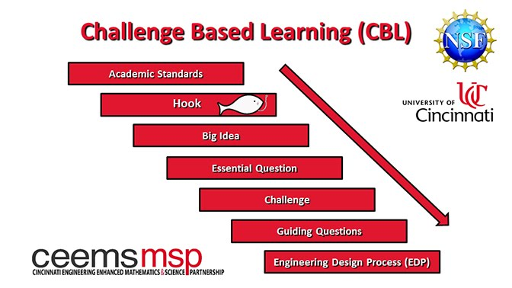
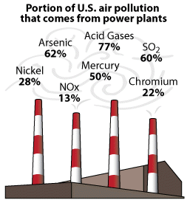
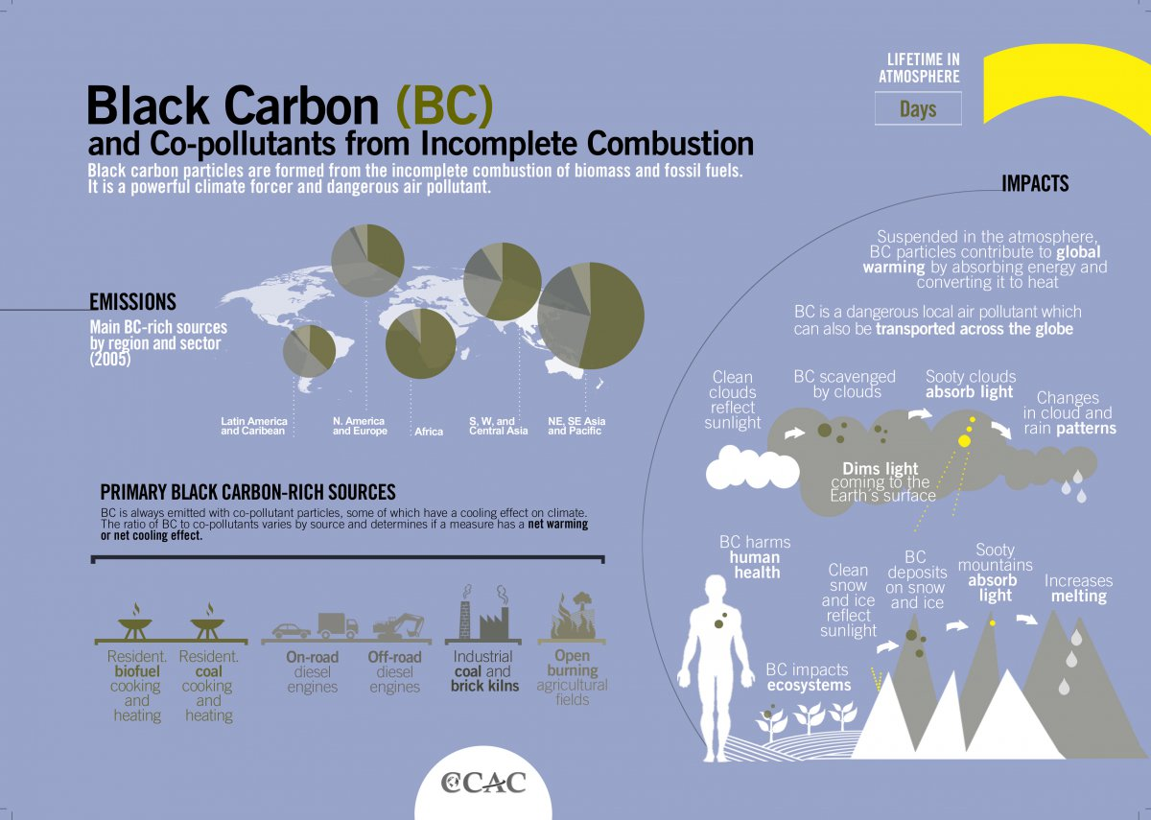
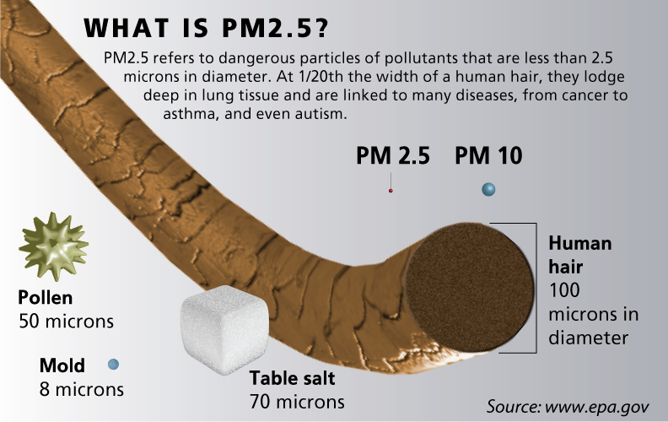
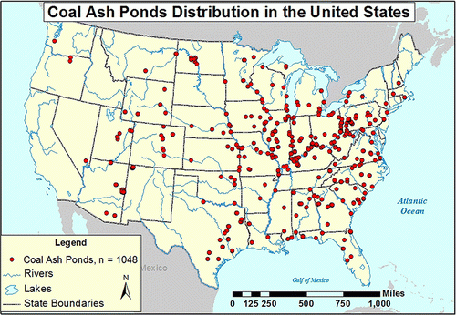
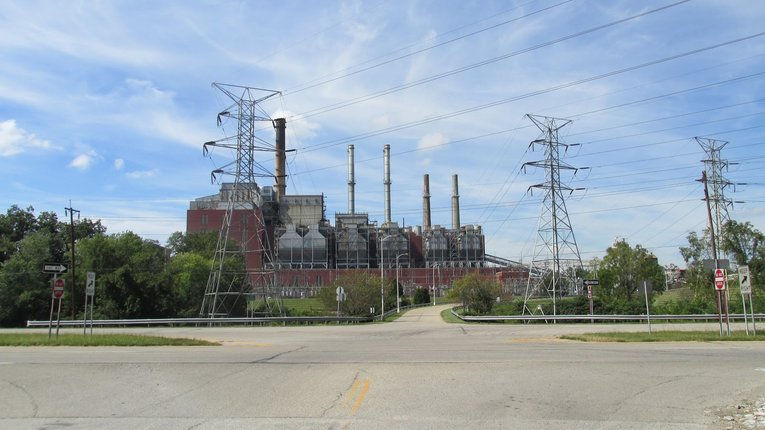
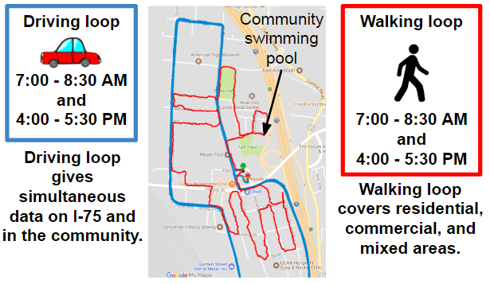
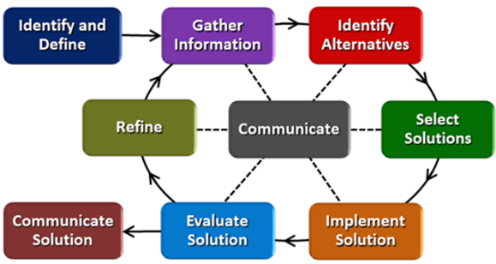
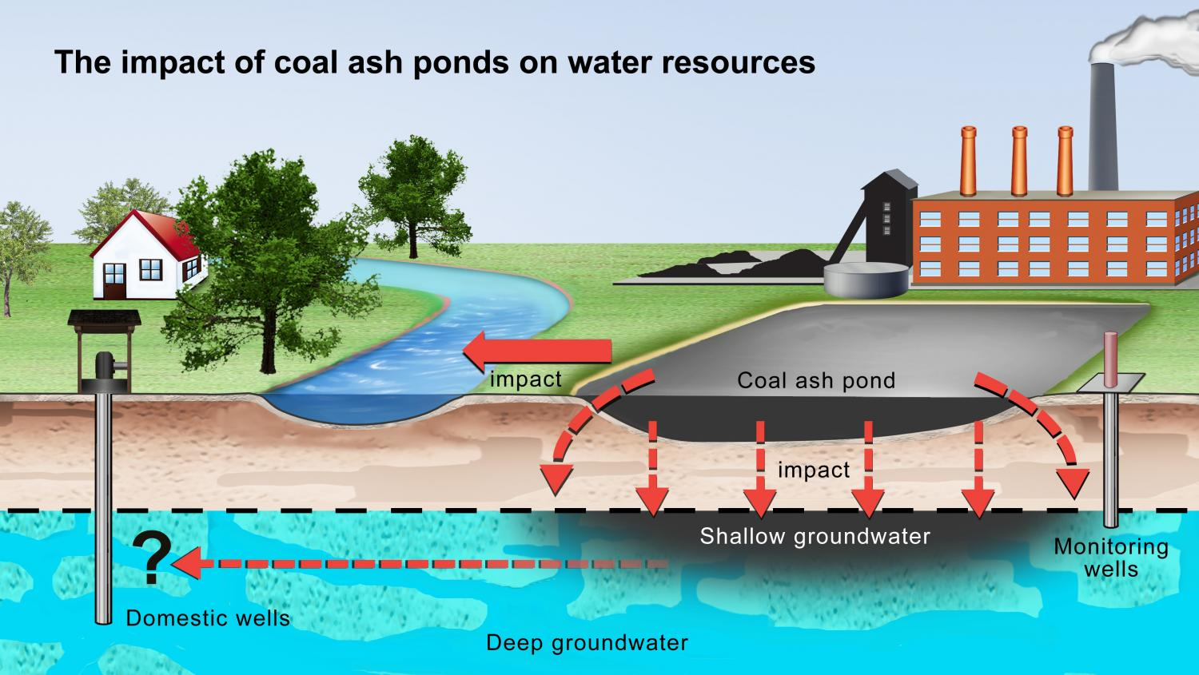
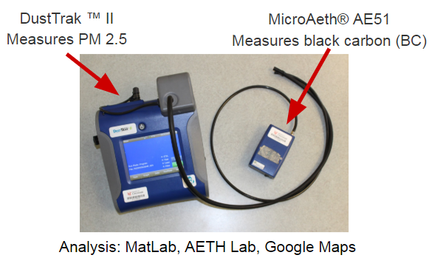
Air Quality Monitoring Marie Pollitt Felicity-Franklin Middle School, 8th Grade Science
RET is funded by the National Science Foundation, grant # EEC-1710826.
Summer Research
Classroom Connections
Societal Impacts
Big Idea
Air Quality Monitoring Near a Major Roadway
The Problem
How does air pollution generated on I-75 and in the railyard affect life expectancy in Camp Washington?
The Campaign
Research Training Received
Big Idea
Pollution and the Environment
The Clean Air Act is designed to control air pollution to protect families from harmful pollutants that can cause asthma and lung disease. In 2011, coal- and oil- fired power plants were ordered to lower the amount of mercury and toxic air pollution being released into the environment.
www.epa.gov/mats/cleaner-power-plants
www.ccacoalition.org/en/slcps/black-carbon
www.pollutionairmask.com/exposure-to-air-pollution-particulate-matter-pm2-5-may-cause-liver-damage/
Benefits of CBL & EDP
Increases student...
Motivation
Engagement
Achievement
21st Century Skills
W.C. Beckjord Station
www.facingsouth.org/2012/10/scientists-find-high-levels-of-coal-ash-contamination-in-north-carolina-rivers-and-lakes.htm
Engineering Design Process (EDP)
The Problem
By Aesopposea from Wikimedia Commons
In the late 1980s, a public drinking well in Clermont County was shut down due to contamination from the ash ponds. Many fear the possibility of the ash ponds breaking and leaking toxins into the Ohio River.
phys.org/news/2016-06-coal-ash-ponds-leak-toxic.html

